Slide 1
Data Provisioning Using SLT

Slide 2
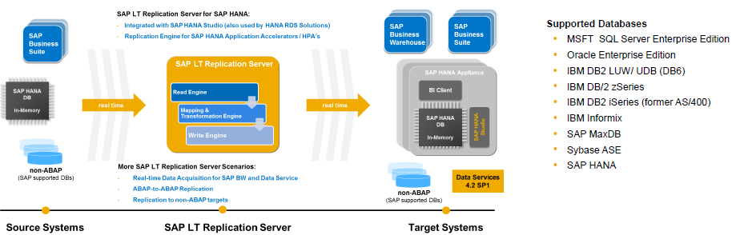
SLT stands for "SAP Landscape Transformation Replication Server" running on the SAP NetWeaver platform.
SAP LT Replication Server is the best solution for real-time data replication from ABAP and non-ABAP (SAP NetWeaver supported databases ) source systems into SAP HANA, SAP Business Suite, SAP Business Warehouse and SAP Data Services.
The change data capturing technology minimizes the transfer volume by transferring only delta data to the target systems.
SAP LT Replication Server is embedded in your landscape and can be deployed without disrupting your existing operations.

Slide 3
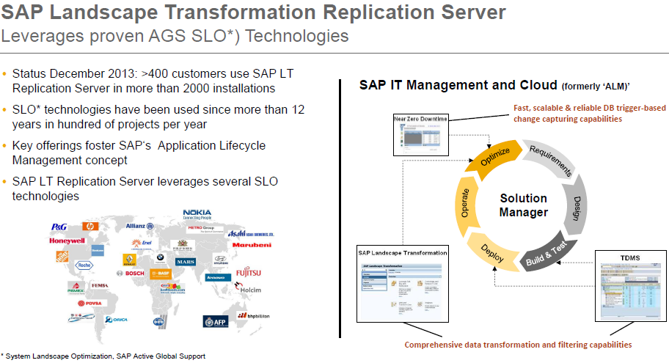

Slide 4
S L T Replication Server - Benefits
Allows real-time (and scheduled) data replication
Ability to automatically migrate data into HANA format while replicating data in real-time
“Unlimited“ release coverage (from SAP R/3 4.6C onwards) sourcing data from ABAP based SAP applications
Handling of all SAP Data Structures (i.e. cluster and pool and HR tables)
Automatically non-Unicode to Unicode conversion during load/replication
Data and structure transformation capabilities (e.g. data filtering, enrich/reduce target table structure, anonymize data, adjust technical table parameters, etc.)
Fully integrated with SAP HANA Studio (Data Provisioning and Data Modeler UI)
Enhanced monitoring capabilities via SAP Solution Manager 7.1 SP5 onwards & mobile app SAP Replication Manager

Slide 5
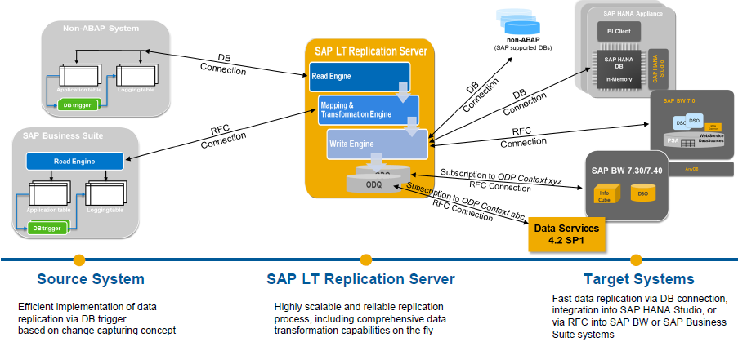
Overview – Trigger-Based Approach

Slide 6
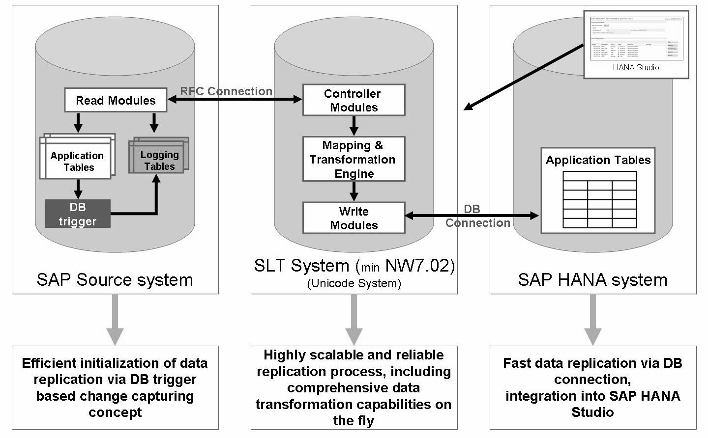
Architecture for SAP Source Replication

Slide 7
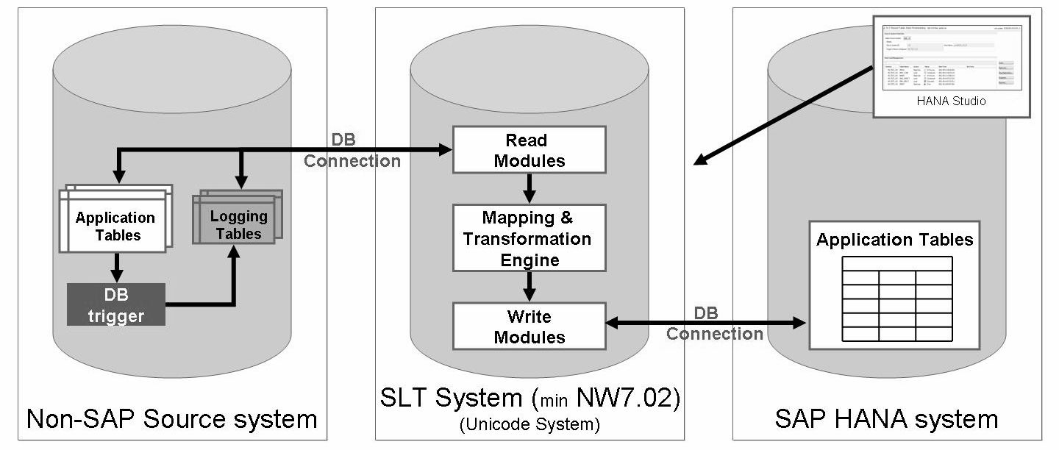
Architecture for Non-SAP Source Replication
For non-SAP source systems, the customer database license needs to cover a permanent database connection with 3rd party products like SAP LT Replication Server.

Slide 8
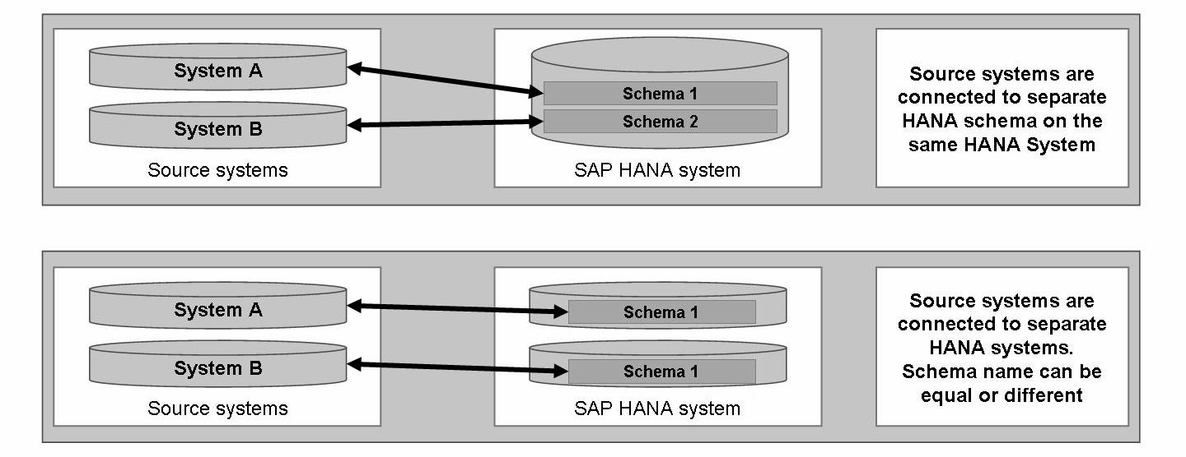
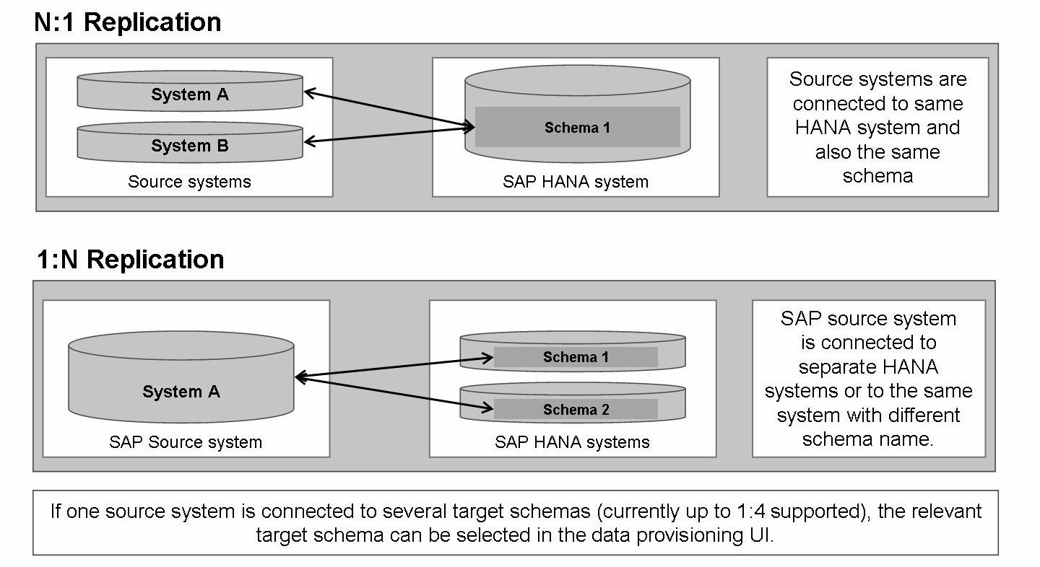

Slide 9
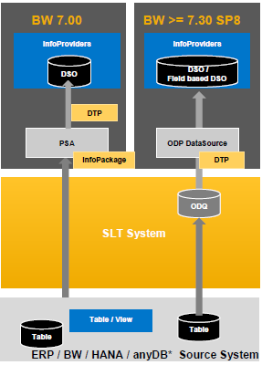
Replicate to SAP NetWeaver BW
Scenario
For SAP BW 7.00 onwards, data can be transferred into the PSA layer of BW into WebService DataSources and then processed into the InfoProviders.
With Support Package SP8 of BW 7.30, the Operational Data Provisioning Infrastructure can be used with SLT, where the data from the source systems is stored and SAP BW is registered as a consumer.
Value Proposition
Using SAP LT Replication Server to transfer data in real-time into SAP NW BW reduces the amount of overnight data uploads into your BW systems. With SAP LT Replication Server you can perform delta updates on BW DataSources without delta mechanisms, for ABAP-based systems as well as non-ABAP based systems on all SAP supported DB versions (according to PAM).
If you use operational data provisioning, you can load the data directly into the InfoProviders (bypassing the PSA layer) by using a DTP (Data Transfer Process) (as of SAP BW 7.30 SP8). The ODP infrastructure (with delta queues) takes over important services such as monitoring data requests.

Slide 10
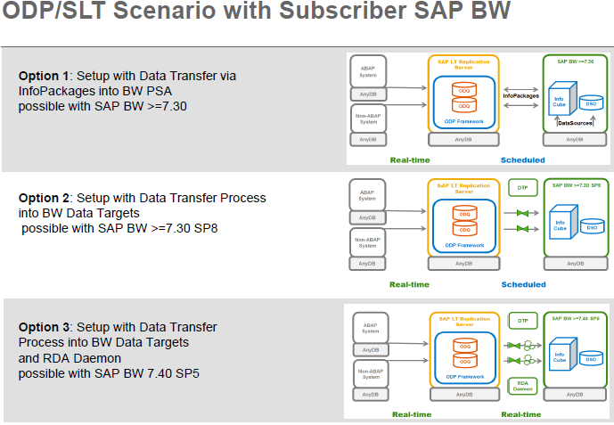

Slide 11
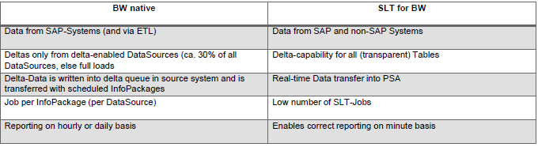

Slide 12
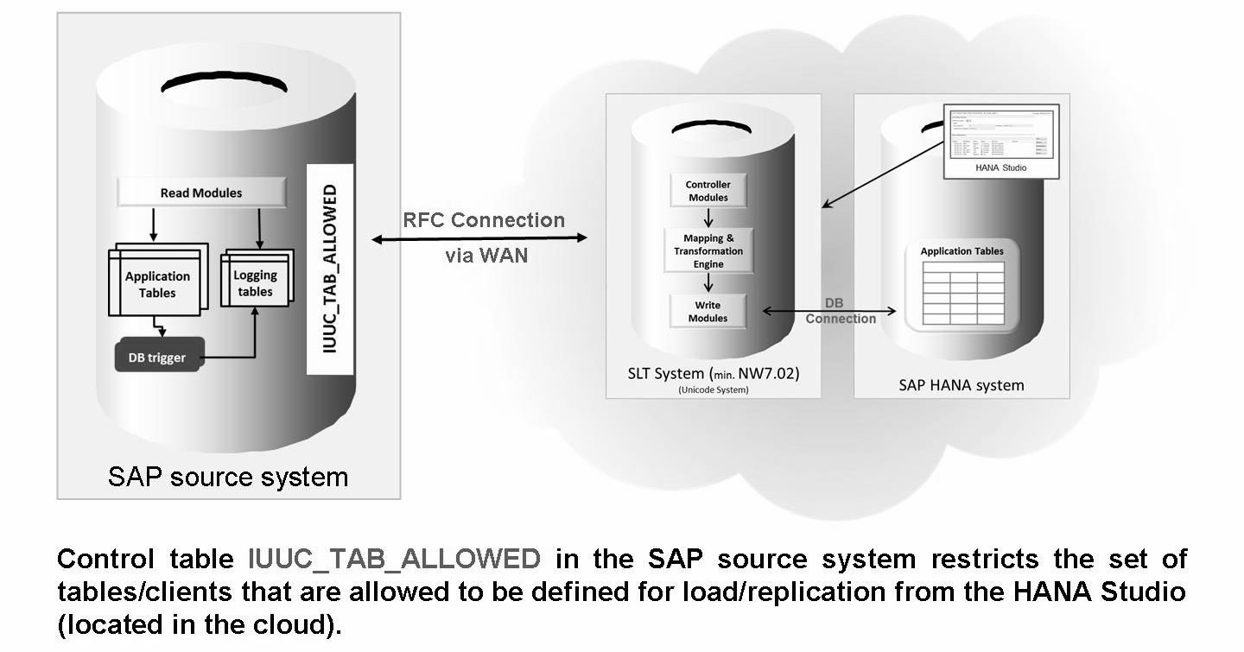
Replicate to HANA in the Cloud
2 possible HANA Inbound Scenarios
SLT located on the on-premise source site (possible)
SLT located besides the SAP HANA system in the Cloud (recommended)

Slide 13
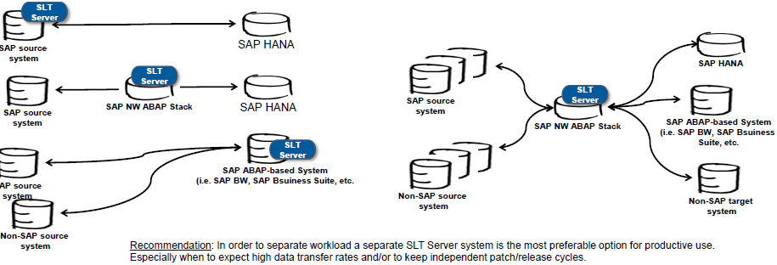
Installation options
SAP LT Replication Server is technically an ABAP Add-on to the SAP NW ABAP-Stack. Therefore, several installation options are technically possible:
On the/a SAP ABAP-based source system, i.e. a SAP Business Suite System (with SAP Basis 7.0.2 or higher)
On a separate SAP NW ABAP Stack (Release 7.0.2 or higher)
On a SAP ABAP-based target system, i.e. a SAP BW or SAP Business Suite System (with SAP Basis 7.0.2 or higher)

Slide 14
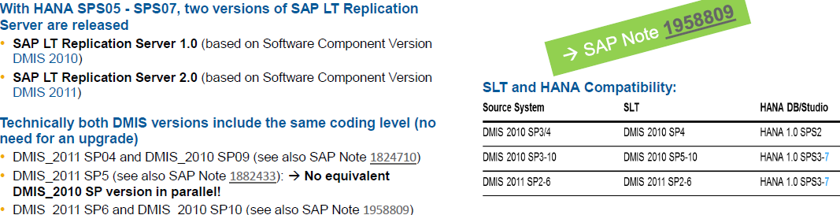
Versions
Jobs
Monitoring Job: The monitoring job checks the HANA system to determine whether there are new tasks, and triggers the master control jobs. It also deletes all records of processed tasks from table RS_ ORDER in the corresponding HANA schema, and updates table RS_STATUS with statistical information.
Master Control Job: This job is started on demand by the monitoring job and is responsible for creating database triggers and logging tables in the source system, creating tables and synonyms in the SAP HANA system, and for generating either the load object or the replication objects.
Data Load Job: This job is responsible for loading and replicating data.
NOTE: There is a direct relationship between the number of replication jobs in the SAP LT Replication Server system and the number of background work processes for the ERP source system.

Slide 15
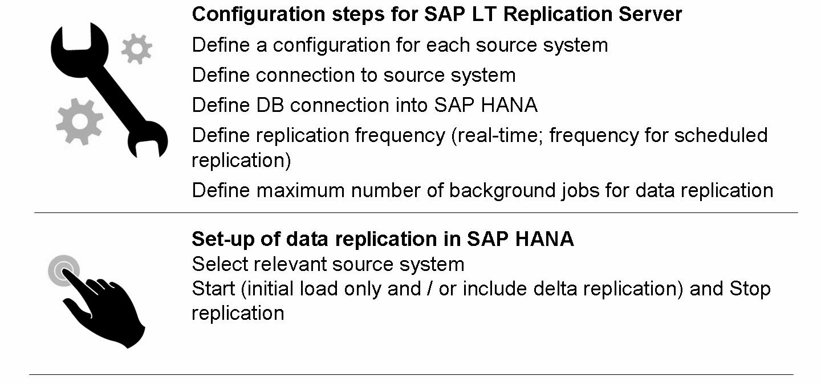
Set-up of LT Replication Server

Slide 16
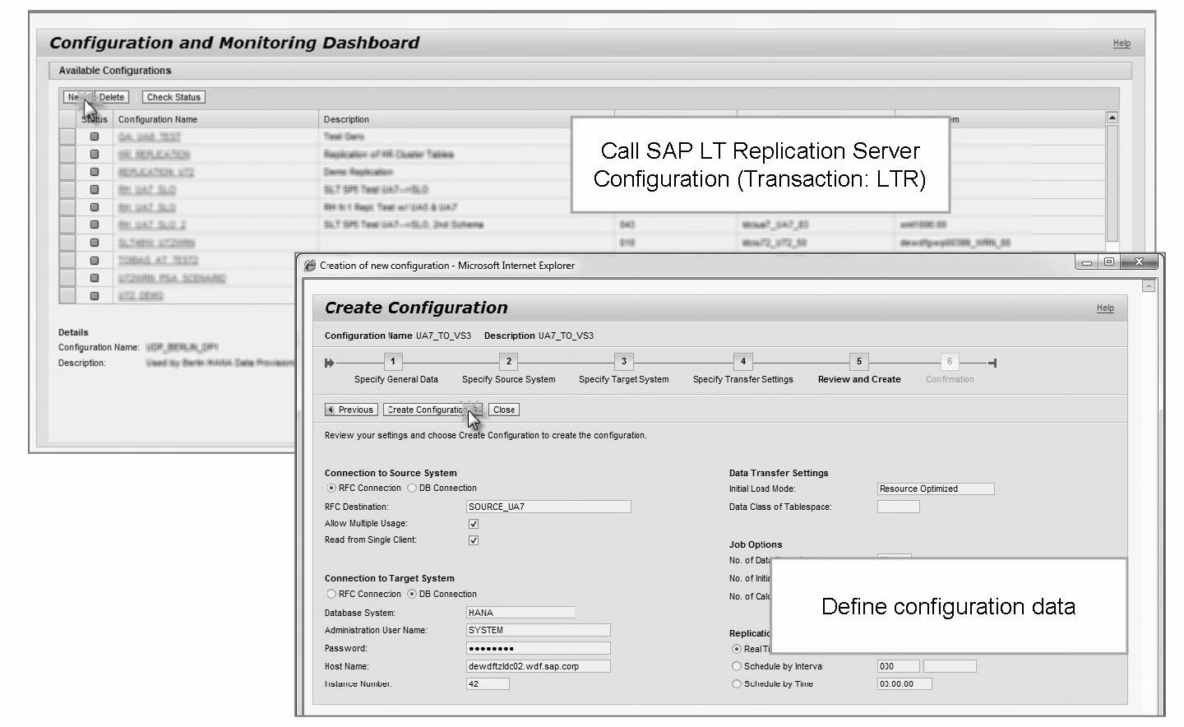
Key Configuration Steps

Slide 17
When the creation of a new configuration is confirmed, the following actions are performed automatically:
Configuration settings are saved on the LT Replication Server.
New user and schema are created on the HANA system with the defined target schema name (not performed if an existing schema is reused).
Replication control tables (RS_& tables) are created in the target schema.
User roles for the target schema are created:
<target_schema> DATA_PROV -Role to manage data provisioning
<target_schema> POWER_USER -Contains all SQL privileges of the target schema
<target_schema> USER_ADMIN -Role to execute authority procedures
A procedure to grant (RS_GRANT _ACCESS) or revoke (RS_REVOKE_ACCESS) are created in the target schema.
Replication of tables DD02L (stores the table list), DD02T (stores the table short descriptions), and DD08L (R/3 DD: relationship definitions) is started automatically. Once those tables are replicated, the HANA studio knows which tables are available in the source system.
SYS_ REPL and table RS_ REPLICATION_ COMPONENTS are created (if they do not exist already based on a previous configuration) and Replication is registered in table RS_REPLlCATION_COMPONENTS .
Most relevant replication control tables are:
• RS_ORDER
Table which temporarily stores the data provisioning requests (e.g. replication) to be processed by the LT Replication.
• RS_STATUS
Stores the data provisioning status (current and historical) for each table processed by the LT Replication.

Slide 18
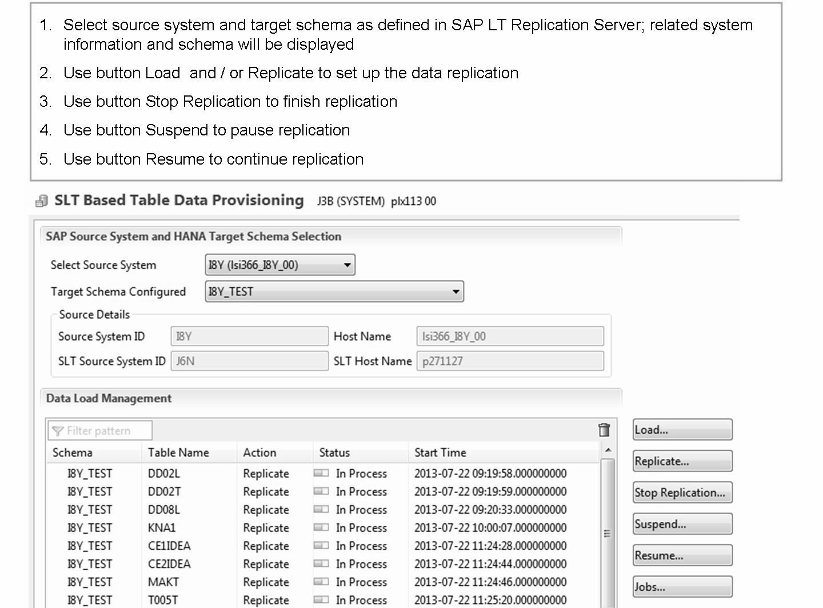

Slide 19
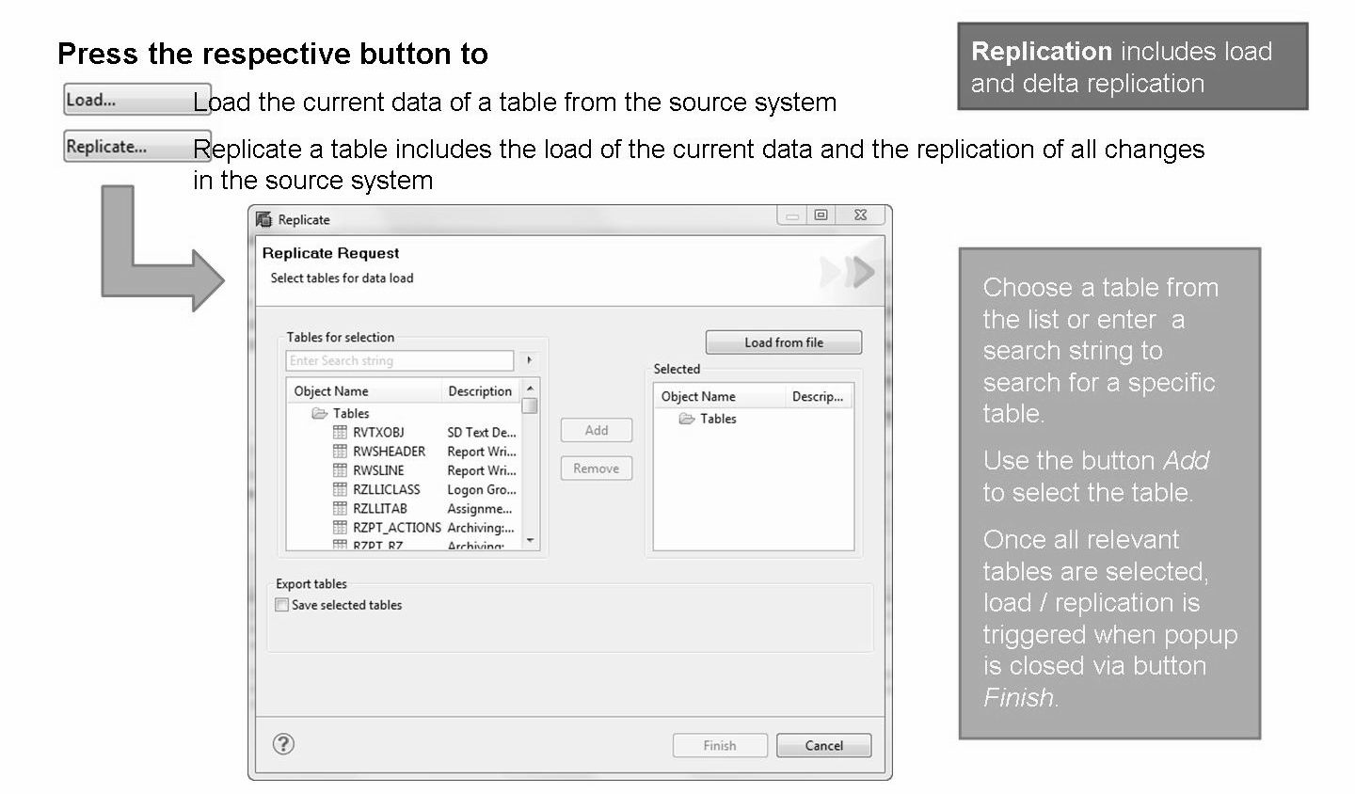
Start Load / Replication

Slide 20
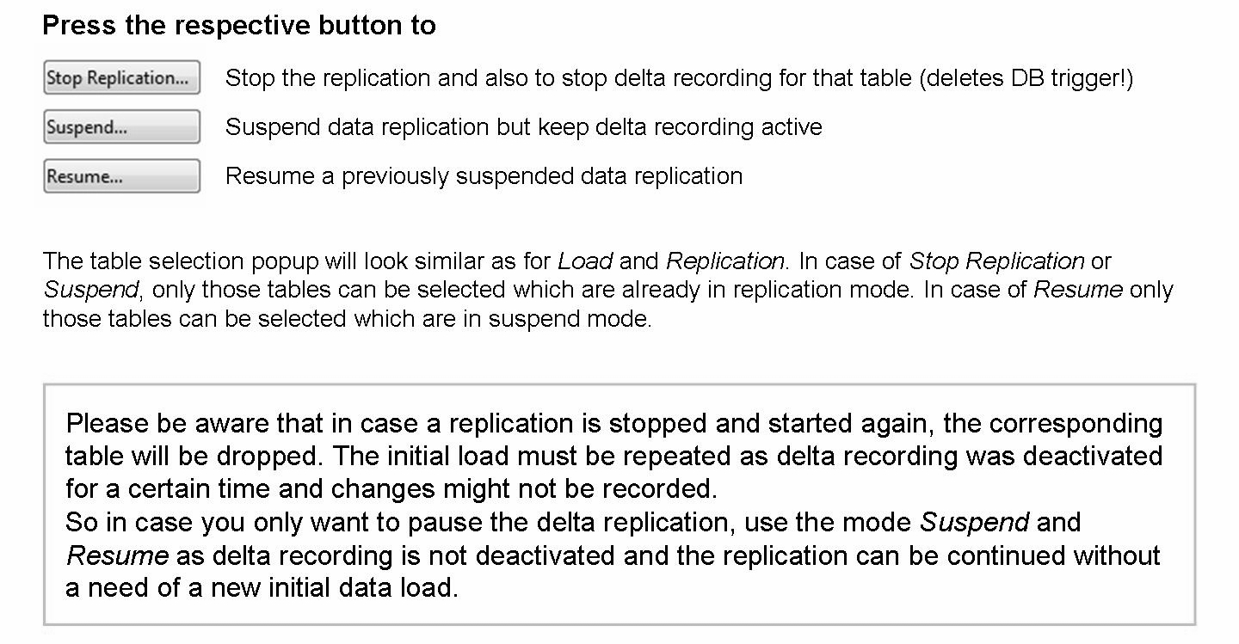
Stop / Suspend Replication

Slide 21
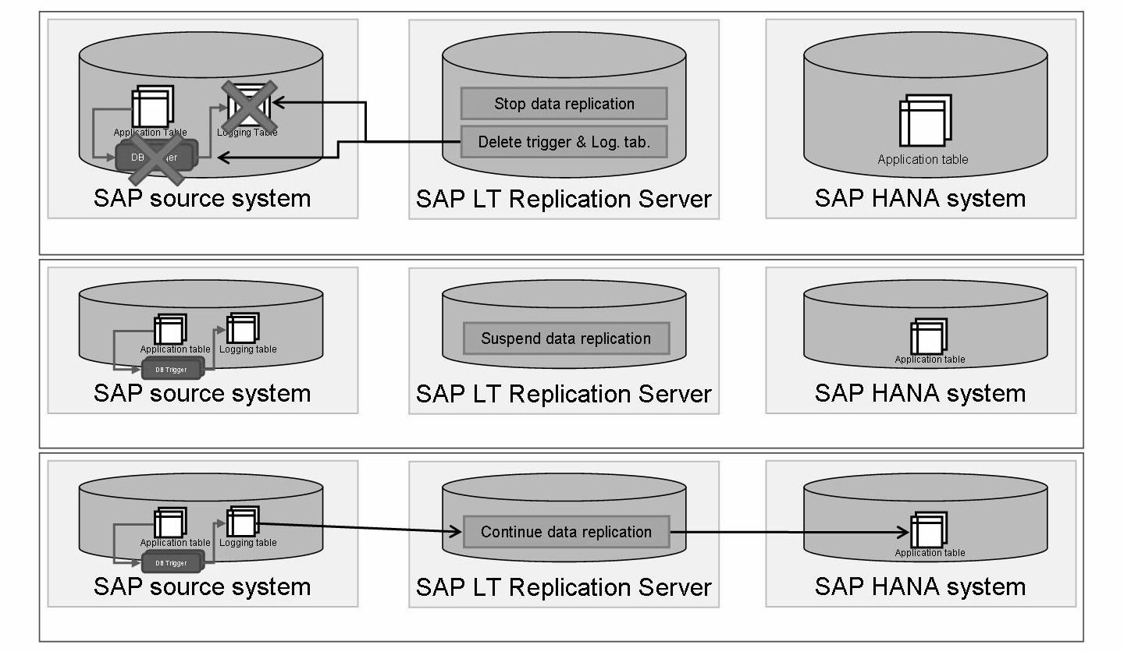

Slide 22
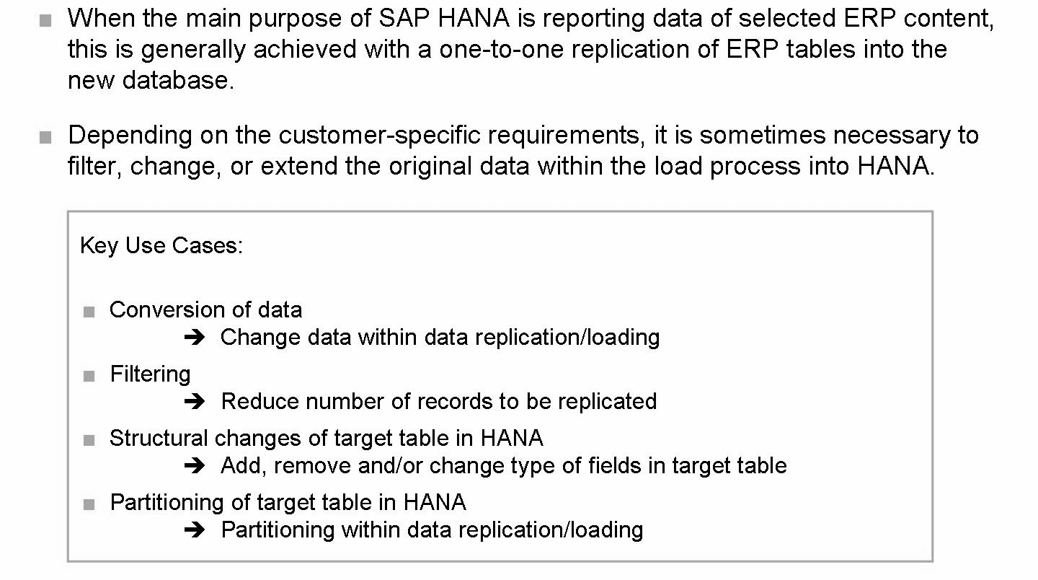
Advanced Replication Settings

Slide 23
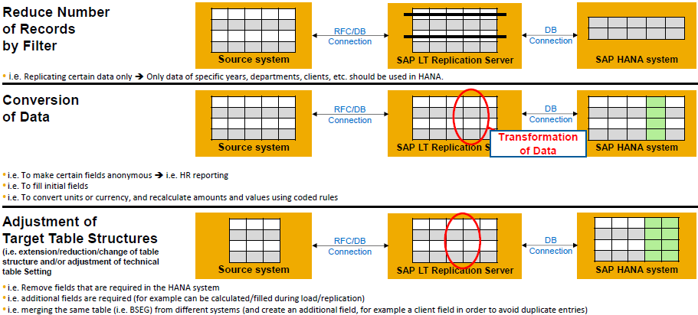
Advanced Replication Settings

Slide 24
Generally, there are two types of transformations rules, which can be used within transformation
Both has to be created as ABAP include, which can be embedded into replication
Column based
A column based rule will be executed at each transferred record, it is easy to implement and it can accept up to 3 input parameters.
Its logic can be written in a single line of code up to 72 characters long directly in the advanced replication settings transaction, or it can be written in a custom ABAP include, whose name is also specified in the advanced replication settings transaction.
Less flexible than event-based rules
Event based
More flexible than parameter-based rules
Knowledge of data processing within the SAP LT Replication Server needed to select the right event for the specific business scenario
Has access to all fields of a record
The advantage of event based rules over parameter based rules is a greater flexibility and the chance to improve performances

Slide 25
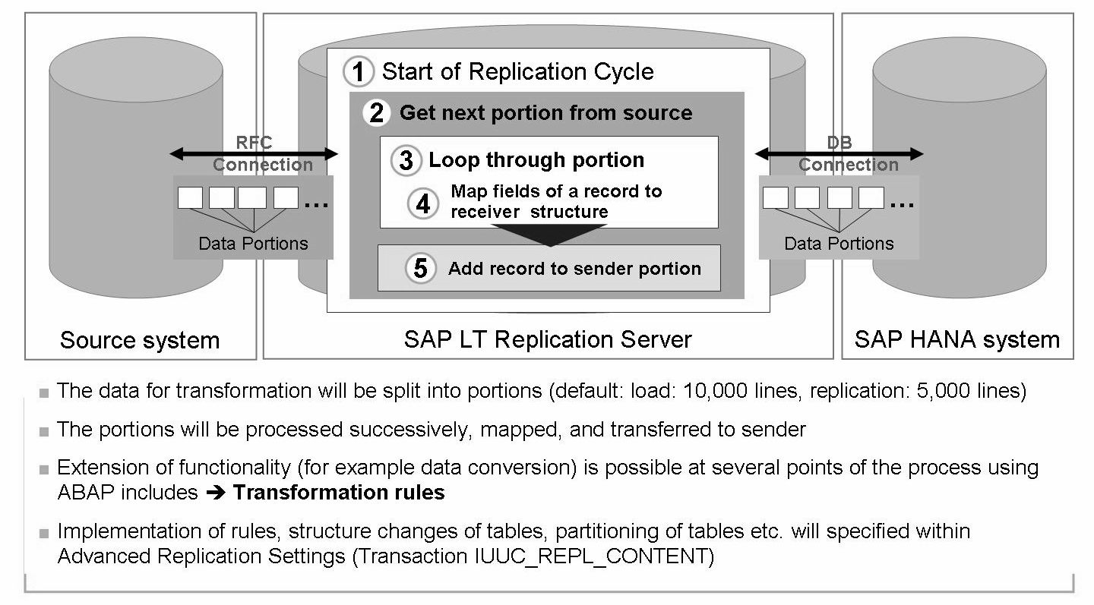
Event based transformation rules

Slide 26
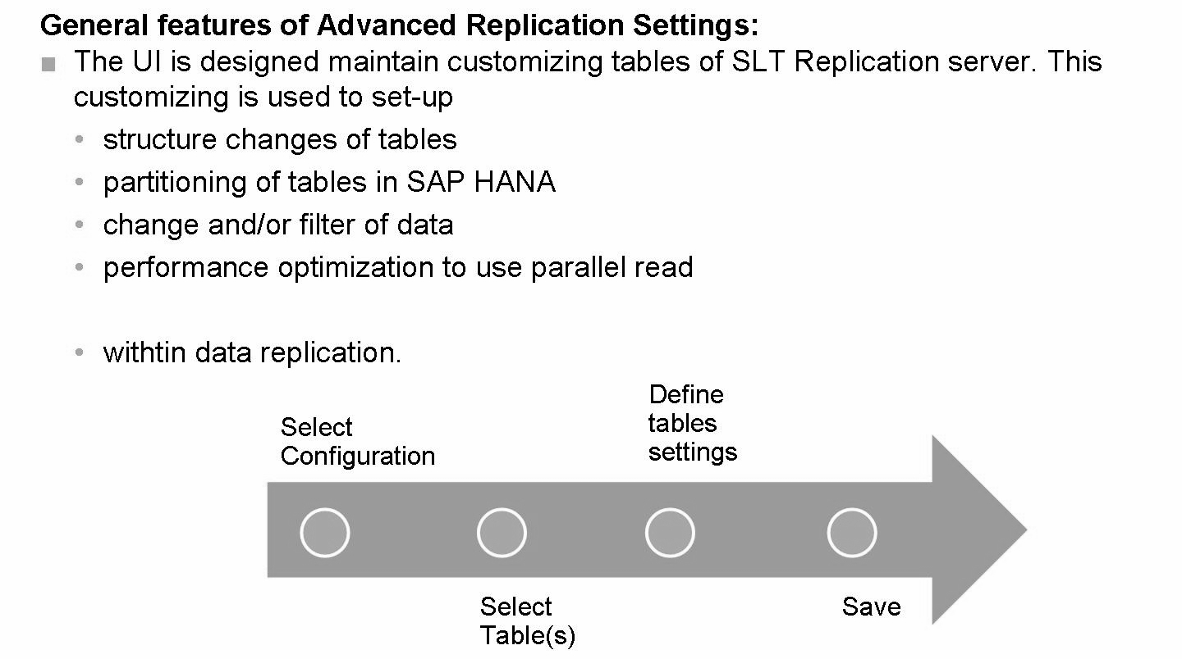
The advanced replication settings for a table are maintained in transaction IUUC_REPL_CONTENT (in SLT up to SP5) or transaction LTRS (from SLT SP6), before starting the replication/load of that specific table.

Slide 27
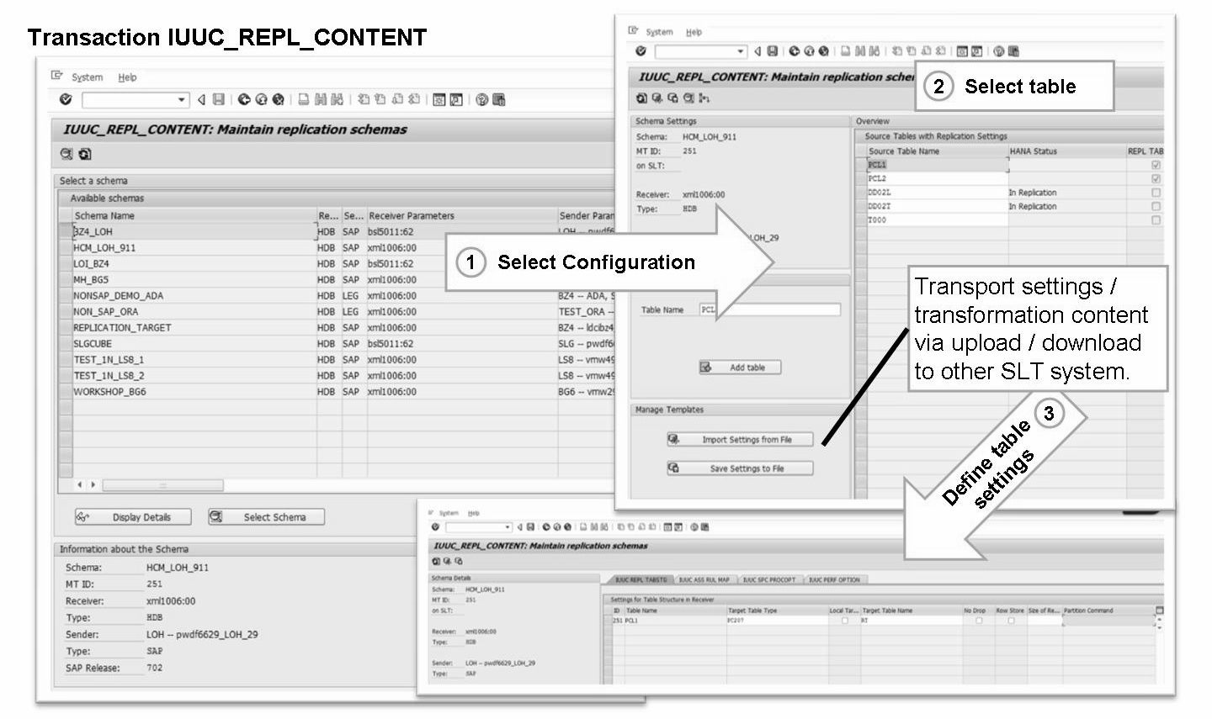

Slide 28
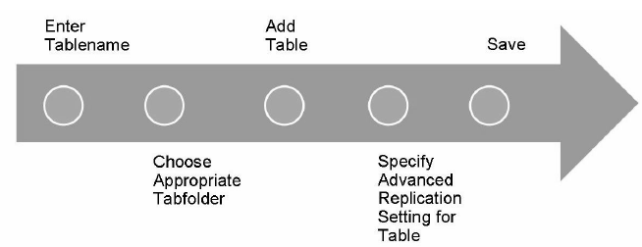
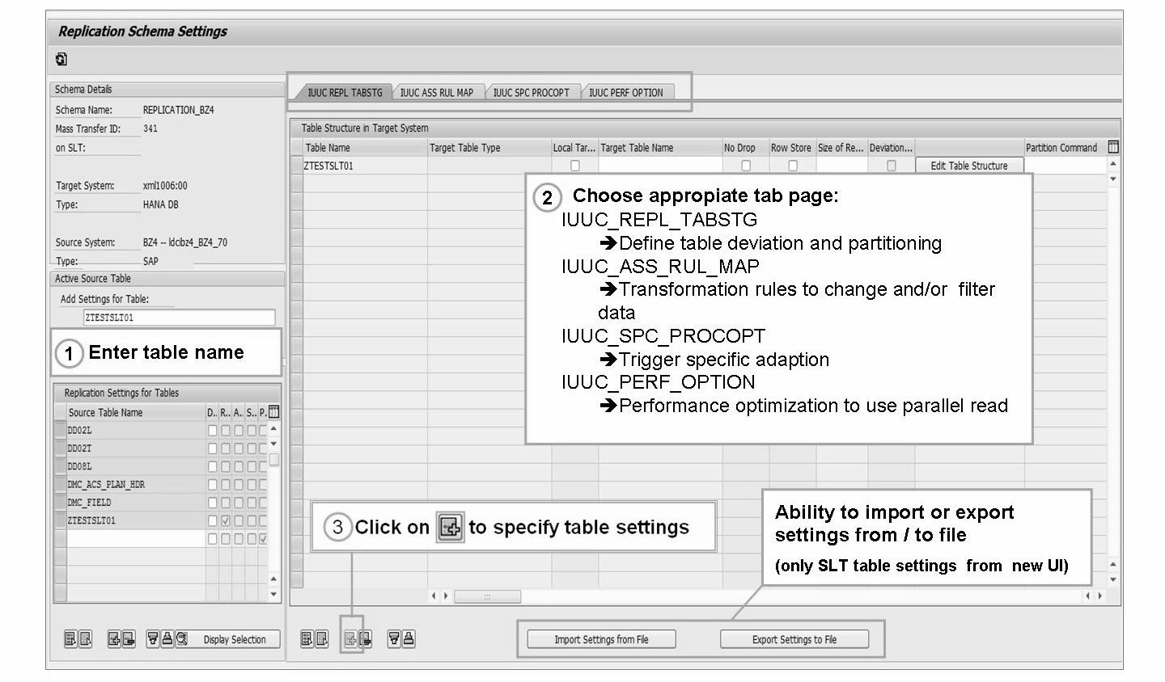

Slide 29
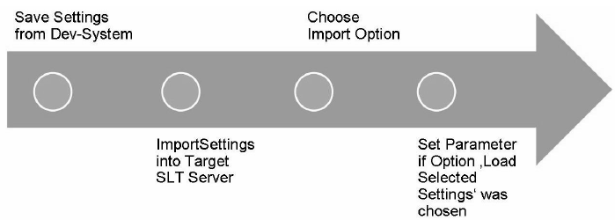
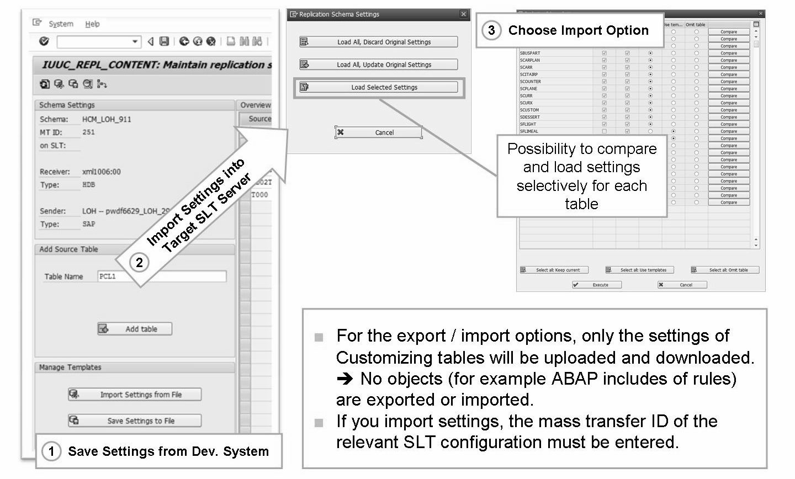

Slide 30
Monitoring of Replication
Configuration & Monitoring Dashboard
(Transaction: LTR)
Issue with monitoring job
Alert - trigger failures
Basic statistics on replication time
Cockpit Functions
(Transaction: LTRC)
Check correct creation logging tables / triggers
Review details on runtime and data throughput
Analyze and identify replication errors using Application log

Slide 31
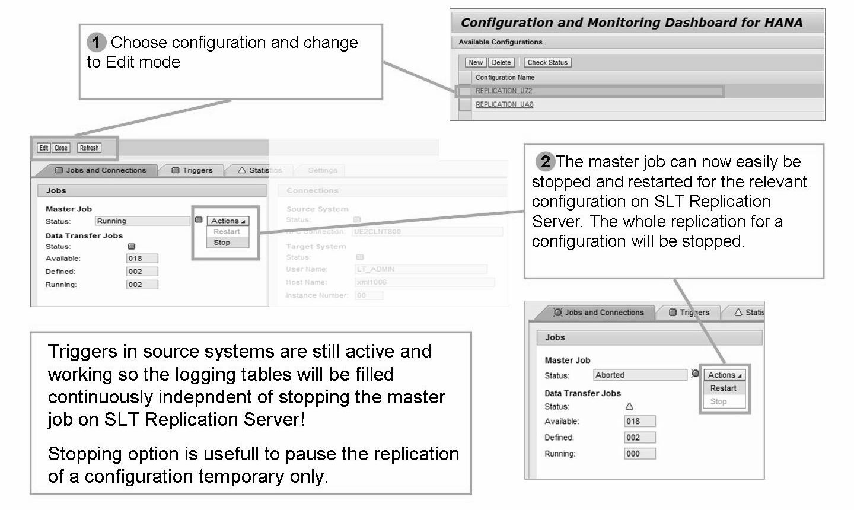
Stopping Master Job (LTR)

Slide 32
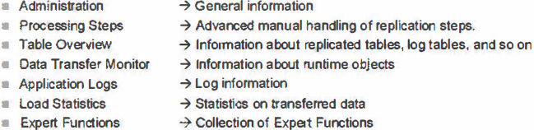
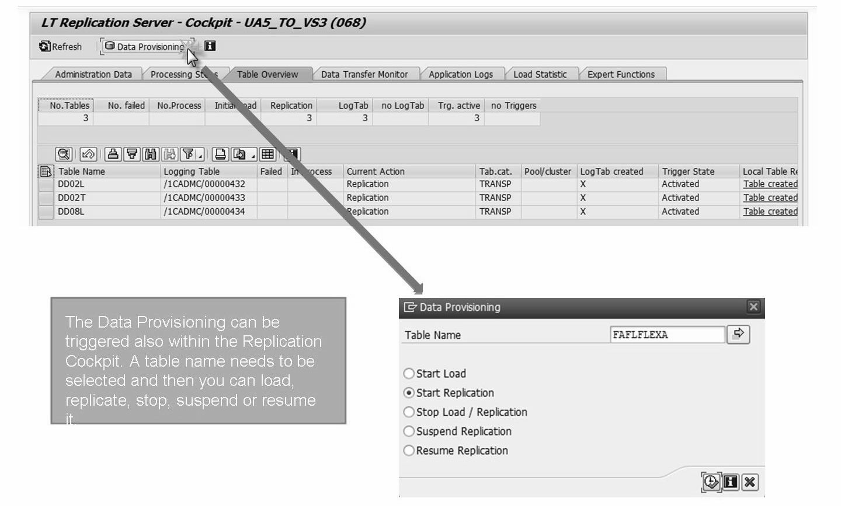
Replication Cockpit (LTRC)

Slide 33
THANK YOU
Courtesy : SAP Labs Document -
HA 350 – Data Provisioning

